Slide 1

Department of BES-II
BASIC ELECTRICAL & ELCTRONIC CIRCUITS (BEC)
COURSE CODE : 23EC1203
Topic:
VOLTAGE REGULATORS (LM7805,LM7905)
CO-4
L – 12(Part-1)

Slide 2



AIM OF THE SESSION
To familiarize students with the basic concept of Voltage Regulators
INSTRUCTIONAL OBJECTIVES
This Session is designed to:
Demonstrate the importance of Voltage Regulators
Describe the working of voltage regulator
List out the types of voltage regulators
Describe the applications of voltage regulators
LEARNING OUTCOMES
At the end of this session, you should be able to:
Define voltage regulator
Describe the working operation of voltage regulators (LM 7805, LM 7905)
Summarize the applications of voltage regulators (LM 7805, LM 7905)

Slide 3
INTRODUCTION
Introduction
Voltage Regulator is an electronic device or circuit that maintains a constant output voltage level irrespective of changes in the input voltage, load current, or temperature
Voltage regulator ensures a stable and reliable power supply for electronic devices and circuits
Generally, Voltage regulators are commonly used for laboratory-type power supplies
Voltage regulators are used in a wide range of applications, including power supplies for electronic devices, automotive systems, industrial equipment, and more.

Slide 4
Why Voltage Regulation ??
Necessity of Voltage Regulation
Electronic devices often require a specific and stable voltage to operate efficiently
Variations in voltage can lead to malfunctions, data loss or damage to sensitive components
Many electrical devices are designed to operate optimally within a specific voltage range. Operating outside this range may lead to increased energy consumption and reduced efficiency. Voltage regulation helps maintain the voltage within the specified limits, promoting energy efficiency in electrical systems.
Voltage regulators help to maintain a consistent voltage level, ensuring that the connected devices receive power that is needed for proper functioning

Slide 5
Types of Voltage Regulators
Types of Voltage Regulators according to their working principle
Linear Voltage Regulators
→ These regulators use a series pass transistor to adjust the output voltage.
→ Simple, easy to design, and are suitable for low to moderate power applications
→ Limited efficiency and may often generate heat
Switching Voltage Regulators
→ These regulators switch the input voltage ON and OFF rapidly and use inductors and capacitors to filter the output
→ More complex, and are suitable for high power applications
→ Offer higher efficiency

Slide 6
Types of Voltage Regulators (Contd..)
Types of Voltage Regulators according to the type of voltage generated
Positive Voltage Regulators
Provides regulated positive voltage
LM78XX series (e.g., LM7805 for +5V)
Negative Voltage Regulators
Provides regulated negative voltage
LM79XX series (e.g., LM7905 for -5V)

Slide 7
Advantages, Disadvantages, and Applications
Advantages
Higher efficiency compared to linear regulators, especially for high voltage differences
Suitable for a wide range of input voltages
Reduced heat dissipation
Disadvantages
More complex design
Output may have higher noise compared to linear regulators
Applications
Battery-powered devices
High-power applications (e.g., computers, power supplies)
Automotive electronics .

Slide 8
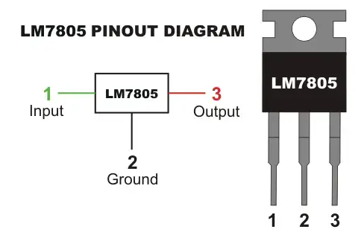
VOLTAGE REGULATOR (LM 7805)
PIN Description
PIN 1 (INPUT)
Input pin gives the input voltage, within the range of 7V to 35V. An unregulated voltage is applied to the input pin for regulation. The maximum efficiency is achieved for an input of 7.2V
PIN 2 (GROUND)
This pin is connected to ground. For the input and output, this pin is equal to neutral voltage (0V)
PIN 3 (OUTPUT)
Output pin is used to receive the regulated output.
Fig.1 Representation of LM 7805 Voltage Regulator

Slide 9
VOLTAGE REGULATOR (LM 7805) Contd..
Characteristic Features
Output Voltage: The LM7805 is designed to provide a fixed positive output voltage of +5V
Input Voltage Range: It can accept an input voltage ranging from 7 volts to 35 volts, making it suitable for regulating higher voltage sources down to +5V.
Output Current Capacity: The LM7805 is available in different variants with varying current capacities. Common variants include LM7805, LM7805C, and LM7805CT, which can handle currents up to 1A.
Linear Regulation: It employs linear regulation to maintain a stable output voltage. Linear regulators dissipate excess voltage as heat, so they may require a heat sink in high-power applications.

Slide 10
VOLTAGE REGULATOR (LM 7805) Contd..
Applications of LM 7805 Voltage Regulator
Current regulator
Regulated dual supply
Building circuits for Phone charger, UPS power supply circuits, portable CD player etc
Fixed output regulator
Adjustable output regulator

Slide 11
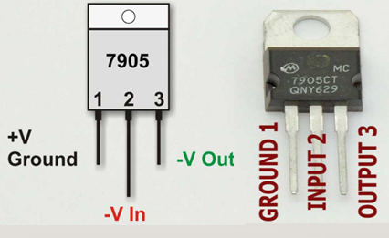
VOLTAGE REGULATOR (LM 7905)
PIN Description
PIN 1 (GROUND)
This pin is an unregulated input voltage
PIN 2 (INPUT)
This pin is connected to ground.
PIN 3 (OUTPUT)
Output pin is used to receive the regulated output of -5V.
Fig.2 Representation of LM 7905 Voltage Regulator

Slide 12
VOLTAGE REGULATOR (LM 7905) Contd..
Characteristic Features
Output Voltage: The LM7905 is designed to provide a fixed negative output voltage of -5 volts.
Input Voltage Range: It can accept an input voltage ranging from -7 volts to -25 volts, making it suitable for regulating higher negative voltage sources down to -5V.
Output Current Capacity: Similar to the LM7805, the LM7905 is available in different variants with varying current capacities. Common variants include LM7905, LM7905C, and LM7905CT, which can handle currents up to 1A.
Linear Regulation: Like other regulators in the LM78xx series, the LM7905 uses linear regulation to maintain a stable output voltage. Heat dissipation may be a consideration, especially in high-power applications.

Slide 13
VOLTAGE REGULATOR (LM 7905) Contd..
Applications of LM 7905 Voltage Regulator
Constant -5V output regulator to for op-amp signals
Adjustable Output Regulator
Current Limiter for certain applications
Regulated Dual Supply

Slide 14

ACTIVITIES/ CASE STUDIES/ IMPORTANT FACTS RELATED TO THE SESSION
Problem:
1. Design a temperature monitoring system using a microcontroller and a temperature sensor. The microcontroller requires a stable +5V supply for proper operation. The following specifications are given:
Microcontroller Input Voltage (VMCU​): +5V
Temperature Sensor Operating Voltage (VSensor​): +5V
Input Voltage Source (Vin​): 9V Battery
Determine i) Dropout voltage (Vd) and ii) Power Dissipation
Solution
(i)
(ii) Assume a load current (I_{load}​) ​ of 50mA
Pd​=(Vin​−Vout​)× I_{load}​
Pd​=(9V−5V)×0.05A=0.2W
Vd​=Vin(min)​−Vout​
Vd​=9V−5V=4V

Slide 15
EXAMPLES
The following are examples where LM 7805 and LM 7905 are used in real-time
Power Supply for Microcontrollers
Connect the input of the LM7805 to an unregulated DC power source (e.g., a transformer or a rectified AC source).
Connect the common ground between the input and output.
Connect the output of the LM7805 to the Vcc pin of a microcontroller.
This ensures a stable +5V power supply for the microcontroller.
Audio Amplifier Power Supply:
Use the LM7805 to power the positive side of an audio amplifier circuit.
Use the LM7905 to power the negative side of the same audio amplifier circuit.
This ensures a stable power supply for both the positive and negative halves of the audio signal.

Slide 16
SUMMARY
LM 7805 | LM 7905
1. Positive Voltage Regulator | 1. Negative Voltage Regulator
2. Provides a regulated positive output voltage of +5 volts | 2. Provides a regulated negative output voltage of -5 volts
3. Used to regulate and provide a stable +5V supply in electronic circuits, often used to power microcontrollers, digital ICs, and other components. | 3. LM7905 is used in applications where a stable negative voltage supply is required, in analog circuitry or situations where a dual power supply (both positive and negative) is necessary

Slide 17
SELF-ASSESSMENT QUESTIONS
What is the primary function of the LM7805 voltage regulator?
Provide a stable +12V output …
Regulate a stable +5V output
Generate a variable output voltage
Act as a digital logic gate
In the LM7805, what is the typical output voltage?
+3.3 volts
+5 volts
+9 volts
+12 volts

Slide 18
SELF-ASSESSMENT QUESTIONS
3. What is the primary purpose of the LM7905 voltage regulator?
Generate a stable +5V output
Regulate a stable -5V output
Provide variable output voltages
Act as a digital logic gate
4. In the LM7905, what is the typical output voltage?
-3.3 volts
-5 volts
-9 volts
-12 volts

Slide 19
TERMINAL QUESTIONS
1. Describe the importance of voltage regulators
2. List out the types of voltage regulators
3. Analyze the working of LM 7805 and LM 7905
4. Summarize the applications of LM 7805 and LM 7905

Slide 20
REFERENCES FOR FURTHER LEARNING OF THE SESSION
Reference Books:
1. A Sudhakar, Shyam Mohan S Palli , Circuits and Networks: Analysis and Synthesis,
TMH, 5e
2. David A. Bell, Electronic Devices and Circuits, 5th Edition
Sites and Web links:
1. Engineering Choice - Basic Electrical Engineering
2. Learn Electronics - SparkFun Electronics
3. https://www.allaboutcircuits.com

Slide 21
Department of BES-II
BASIC ELECTRICAL & ELCTRONIC CIRCUITS (BEC)
COURSE CODE : 23EC1203
Topic:
VOLTAGE REGULATOR-LM723
L-12 (Part-2)

Slide 22
AIM OF THE SESSION
To familiarize students with the basic concept of LM723 and its importantance.
INSTRUCTIONAL OBJECTIVES
This Session is designed to:
Demonstrate the concept of voltage regulator
Describe the working principle of LM723
List out the characterstics of LM723
Describe the importantance of LM723
LEARNING OUTCOMES
At the end of this session, you should be able to:
Define the voltage regulator
Describe the LM723
Summarize the overall concept of LM723

Slide 23
SESSION INTRODUCTION
There are various types of voltage regulators for getting a regulated power supply like 7812, 7805, etc. However, all these regulators provide a fixed value output. For inconsistent voltage regulation, an LM317 IC voltage regulator.
LM723 IC is a changeable voltage regulator, used in the series regulator application with 150mA current o/p without exterior pass transistor.
When we utilize an external transistor, then it supplies 10A current to drive the load. The input voltage supply is maximum 40V & its o/p voltage ranges from 3volts to 40volts.

Slide 24
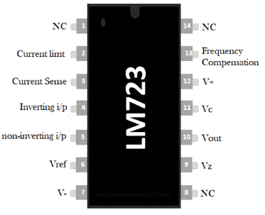
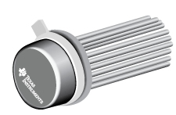
SESSION DESCRIPTION

Slide 25
SESSION DESCRIPTION (Cont..)
Pin1 (NC): Not connected
Pin2 (Current Limit): This pin is used to limit the current
Pin3 (Current Sense): This pin is used in foldback application as well as to limit the current
Pin4 (Inverting Input): This pin provides stable o/p voltage
Pin5 (Non-inverting Input): This pin is used to supply a reference voltage to the inside of the operational amplifier.
Pin6 (Vref): This pin provides an almost 7v reference voltage
Pin7 (-Vcc): GND (Ground) Pin
Pin8 (NC): Not connected
Pin9 (Vz): This pin is generally used to make negative regulators
Pin10 (Vout): This is the o/p pin
Pin11 (Vc): This is the series pass transistor’s collector input. Generally, it is connected directly to the +ve voltage supply if an exterior transistor is not used.
Pin 12 (V+): This is the input of the positive supply
Pin13 (Frequency Compensation): This pin assists in decreasing noise with a 100pf capacitor
Pin 14 (NC): Not connected.

Slide 26
FEATURES OF LM723
The features of the LM723 include the following.
The unnecessary o/p current will be 150mA without using an exterior pass transistor.
The maximum input supply voltage will be 40V.
It offers modifiable o/p from 3volts to 37volts.
These ICs are used to make switching & linear regulator.
It supplies 10A o/p current with the help of an external pass transistor.
These ICs are used for different operations such as positive, negative, series, floating, and shunt.

Slide 27
SPECIFICATIONS
Specifications of LM723
The maximum i/p voltage is 40v
The reference voltage is always 7 volts
Ripple rejection is 74 dB
The current supply from Vz pin is 25mA
The output voltage ranges from 3volts to 37 volts
The range of operating temperature will be from -55°C to +150°C
The current supply from Vref pin is 15mA
The line and load regulation of 0.01%Vout & 0.03% Vout

Slide 28
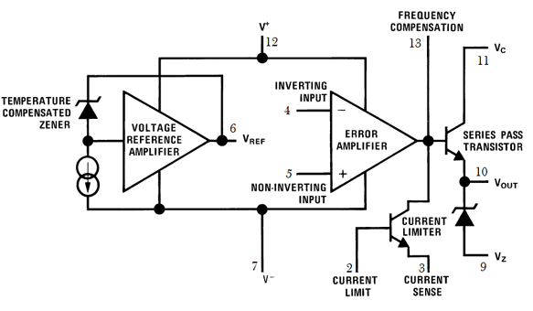
BLOCK DIAGRAM

Slide 29
BLOCK DAIGARM (cont..)
The block diagram can be explained by separating it into two blocks namely the error amplifier and the reference voltage generator.
In the reference block, a Zener diode is being forced to work at set point, so the o/p of the more zener is a permanent voltage with a stable current supply which arrives to produce a stable voltage (7.15V) along with an amplifier on the Vref pin of the IC.
In the error amplifier block, it includes a series pass Q1 transistor, an error amplifier, & a transistor which limits the current. This amplifier is used to contrast the o/p voltage which is given at inverting i/p terminal throughout feedback toward the Vref-reference voltage given at the non-inverting terminal.
The two connections internally not offered & so have to be externally offered in accordance with the required output voltage. The conduction of the transistor Q1 is controlled by the error signal. It is this transistor that controls the output voltage.

Slide 30
ADVANTAGES and DISADVANTAGES
The advantages of LM723 voltage regulator include proven, low noise, the voltage range is wide, support for external pass transistors, recompense by the user, extremely flexible, complete temperature range accessible, and economical.
The disadvantages of LM723 voltage regulator include difficulty, current limiting is not exact, current limiting is sensitive to overload, lowest dropout voltage, least regulated o/p voltage, error amplifier gain is Moderate, error amp bias current, and be careful when using MOSFET pass transistors.

Slide 31
ACTIVITIES/ CASE STUDIES/ IMPORTANT FACTS RELATED TO THE SESSION
Battery Charger:
Activity: Create a battery charger circuit using the LM723 to regulate the charging voltage for rechargeable batteries.
Case Study: Investigate the charging characteristics and efficiency of the LM723-based battery charger for different types of batteries, such as lead-acid or NiMH.
Voltage and Current Regulator:
Activity: Combine the LM723 with external components to create a dual-mode regulator that regulates both voltage and current.
Case Study: Analyze the advantages of having a voltage and current regulation capability in a power supply, especially for driving loads with dynamic power requirements.

Slide 32
SUMMARY
It is an adjustable voltage regulator and the applications of LM723 mainly include a temperature controller, shunt and current regulator. It provides a high range of o/p voltage & current equal to 10A by just inserting a sequence pass transistor through it, by including an extensive range of working temperature.
Thus the integrated circuit capable to withstand for long to use like linear otherwise switching kind regulator. However, this integrated circuit is particularly designed for series regulator function

Slide 33
SELF-ASSESSMENT QUESTIONS
What is the primary function of the LM723 voltage regulator?
A. Digital signal processing
B. Voltage amplification
C. Voltage regulation
D. Audio signal modulation
Which component is typically used to adjust the output voltage in an LM723 voltage regulator circuit?
A. Inductor
B. Resistor
C. Capacitor
D. Transistor

Slide 34
TERMINAL QUESTIONS
In an LM723-based voltage regulator circuit, what is the purpose of the "Comp" terminal?
What does the "Vin" terminal of the LM723 voltage regulator connect to?
Which terminal of the LM723 is used to set the maximum output voltage?
What is the purpose of the "Vadj" terminal on the LM723 voltage regulator?
Which terminal of the LM723 is connected to the reference voltage for setting the output voltage?

Slide 35
REFERENCES FOR FURTHER LEARNING OF THE SESSION
Reference Books:
1. 1.John Bird. Electrical Circuit Theory and Technology, Routledge publishers, 6th edition,
2. Electronic Devices and Circuit Theory 12th Edition - Robert L. Boylestad
Sites and Web links:
1. https://circuitdigest.com/electronic-circuits/lm723-voltage-regulator-circuit-diagram
2. https://www.circuits-diy.com/lm723-adjustable-voltage-regulator-30v-circuit/

Slide 36
THANK YOU
Team – BASIC ELECTRICAL & ELECTRONIC CIRCUITS (BEC)

